Slide 1
Japanese-Canadians

Slide 2
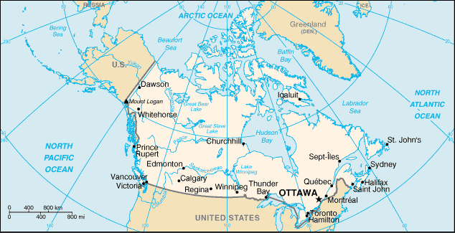
Size - Canada: 9,984,670 sq km Japan: 377,835 sq km - Canada: 33,212,696; Japan: 127, 288,419 - English 59.3%, French 23.2%;

Slide 3
Notes:
Canada: 4.5% arable land, but vast natural resources, continuous permafrost in north is a serious obstacle to development; cyclonic storms form east of the Rocky Mountains, population is 33,212,696 ; 0-14 years: 16.3% (male 2,780,491/female 2,644,276) 15-64 years: 68.8% (male 11,547,354/female 11,300,639) 65 years and over: 14.9% (male 2,150,991/female 2,788,945) (2008 est.); very small pop growth: 0.83% (2008 est.), BUT 5.62 migrant(s)/1,000 population (2008 est.), male: 78.65 years female: 83.81 years (2008 est.)

Slide 4
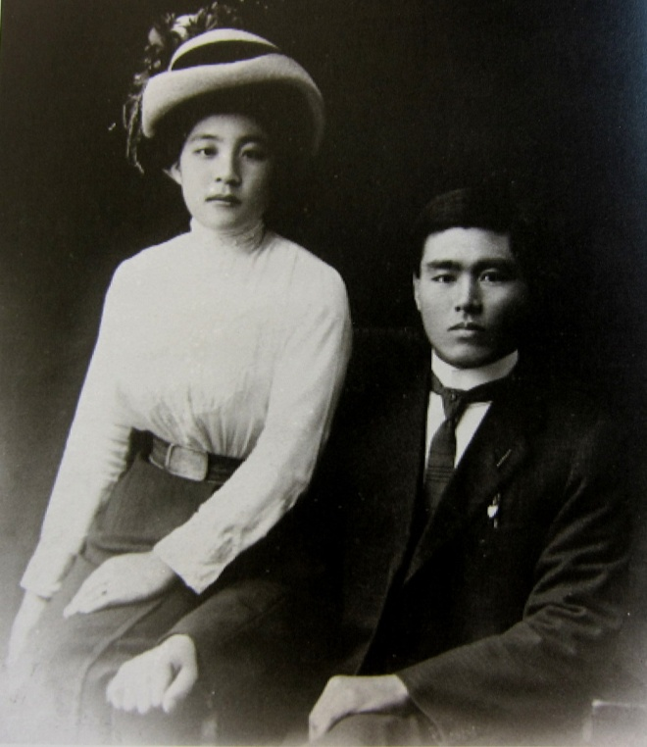
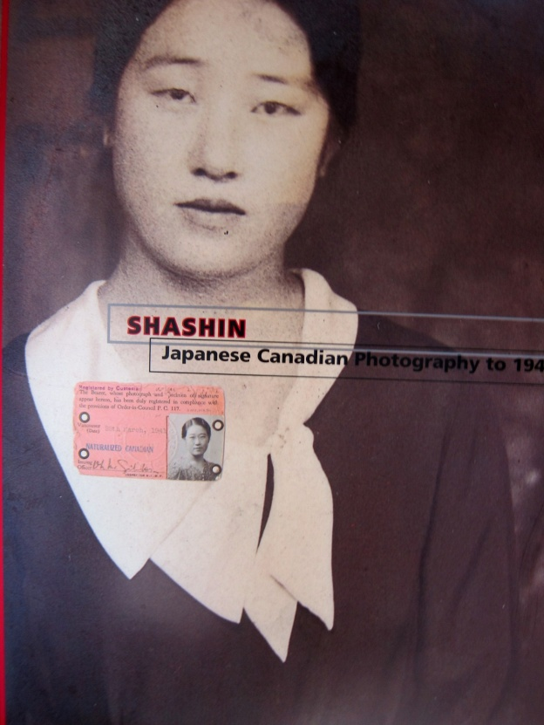
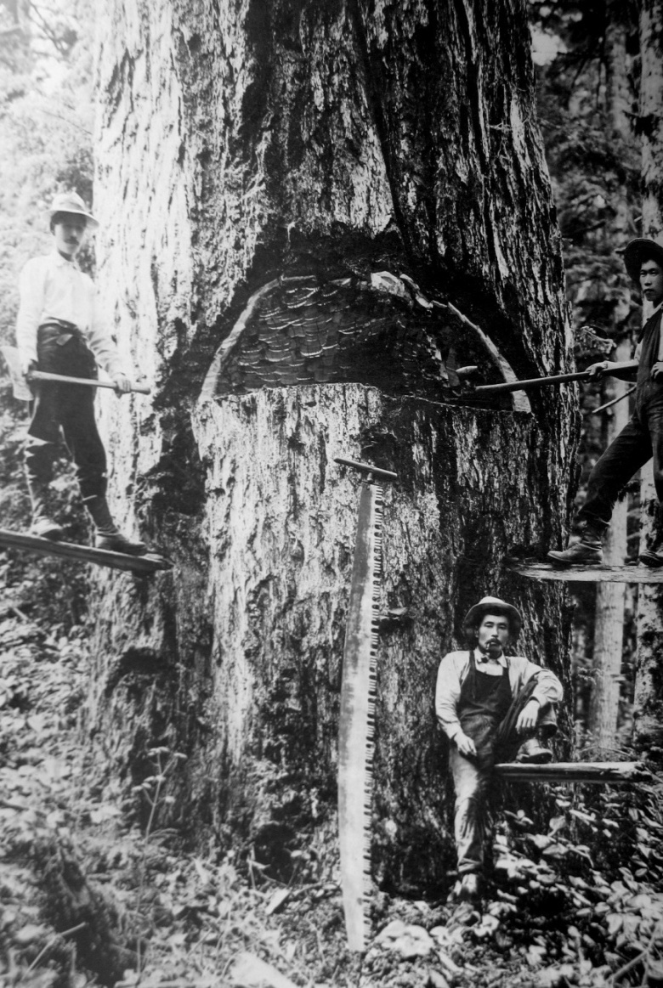
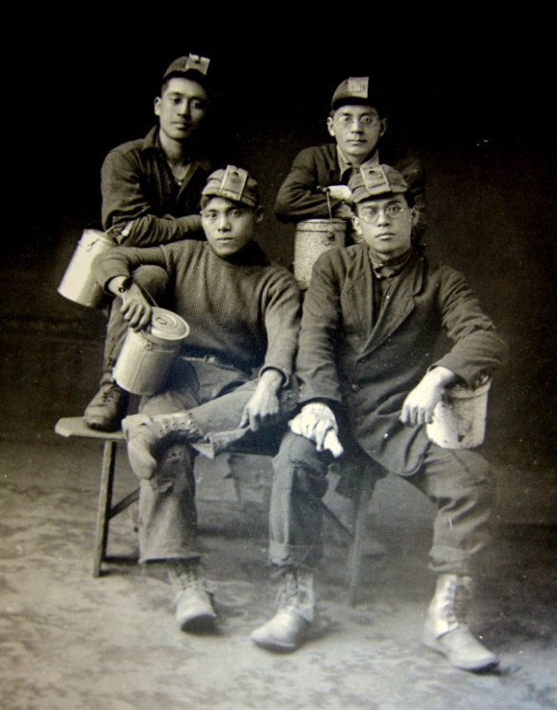
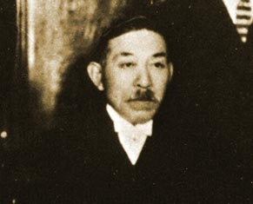
The early Japanese Community in Canada
Nagano Manzo, 1877
sailor from Nagasaki
later salmon fisherman
Mt. Manzo Nagano,B.C.
is named after him
Notes:
1608- founding of 1st permanent settlement in Canada/U.S., Quebec City
Aboriginal peoples came from a land bridge from Asia, perhaps

Slide 5
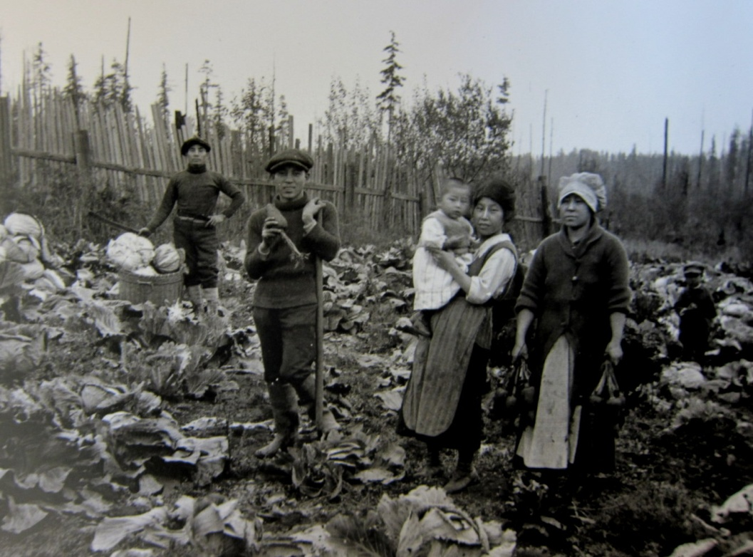
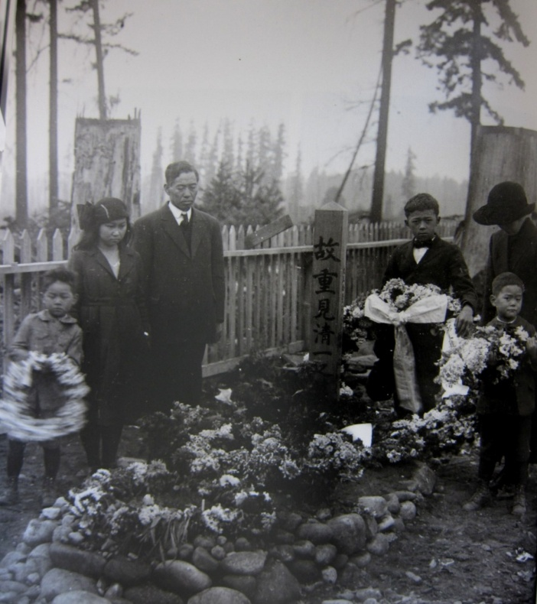
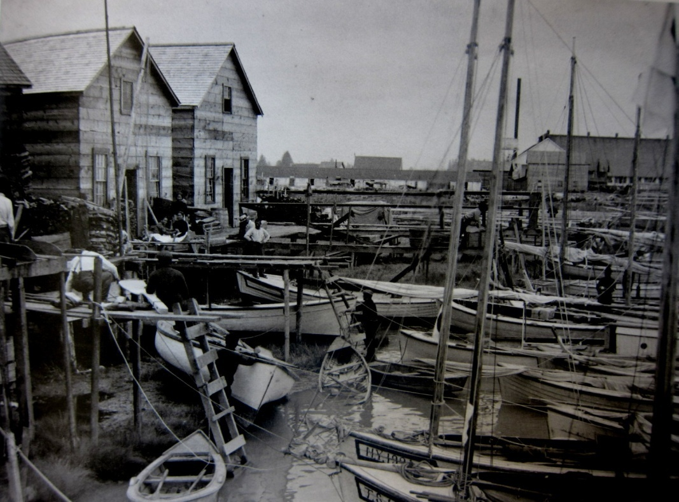
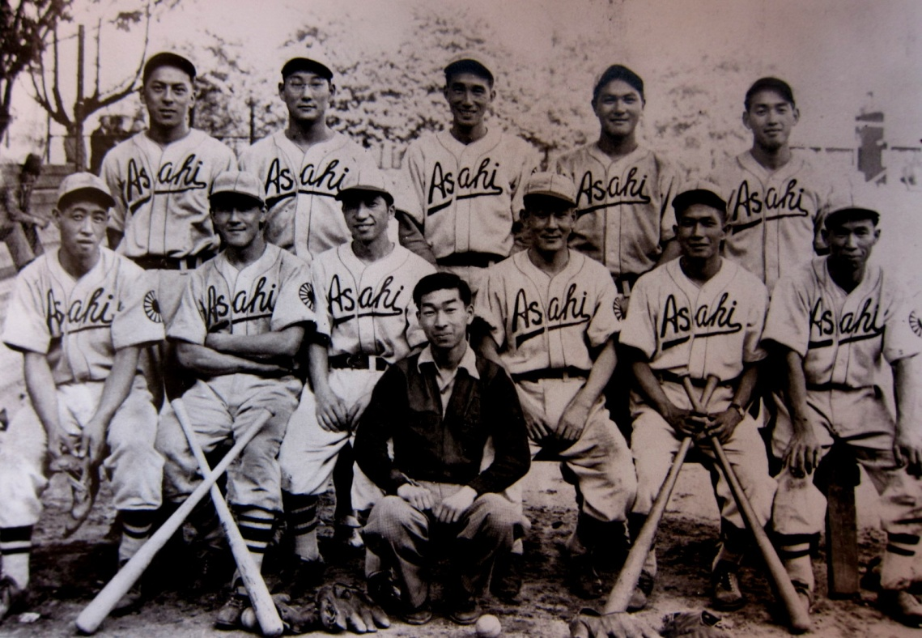
Notes:
1608- founding of 1st permanent settlement in Canada/U.S., Quebec City
Aboriginal peoples came from a land bridge from Asia, perhaps

Slide 6
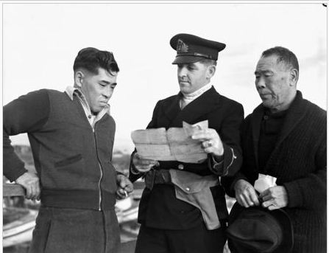
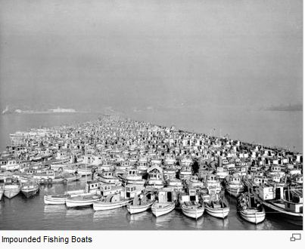
Internment of 22,00 Japanese in 1942 – 1944 in camps near old B.C. towns
▪ loss of freedom, civil rights
▪ government seizure of boats,
houses, and businesses

Slide 7
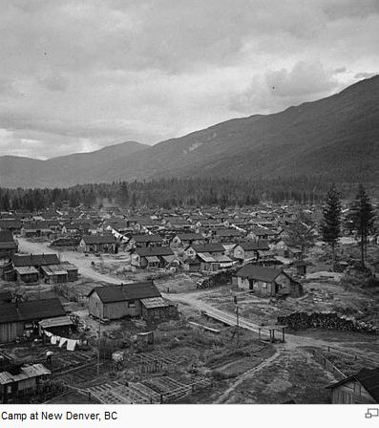
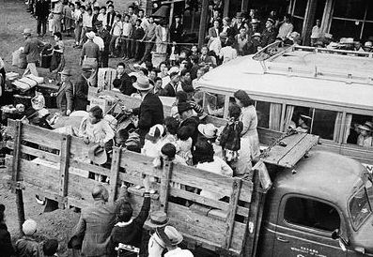
The government auctioned all the property in 1943.
After years of protest, in 1988, the Canadian government apologized and compensated each survivor with $21,000, plus $12 million to the NAJC

Slide 8
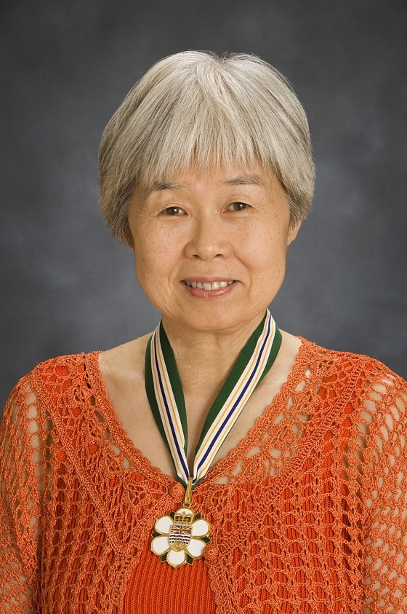
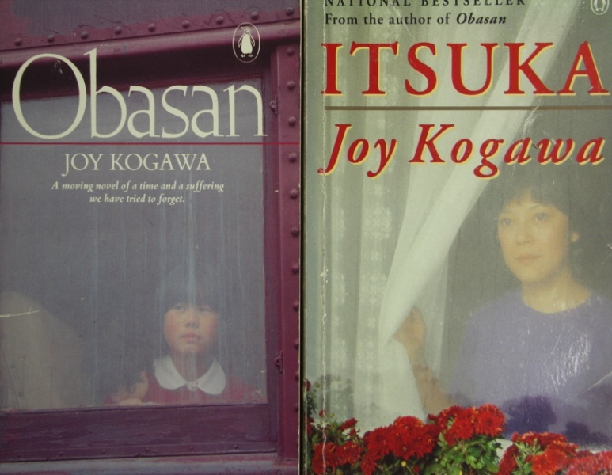
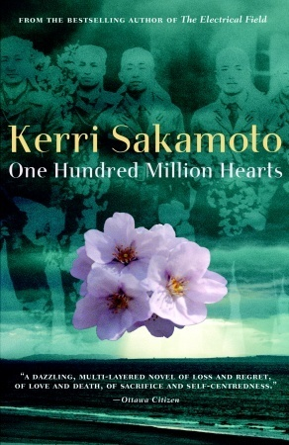
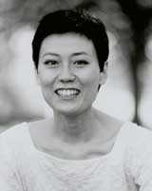
Joy Kogawa
Kerri Sakamoto

Slide 9
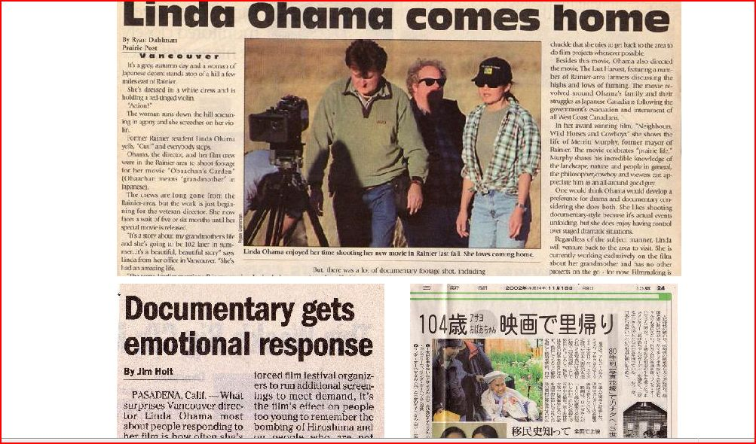
Japanese-Canadian filmmaker of Obachan’s Garden
Linda Ohama

Slide 11
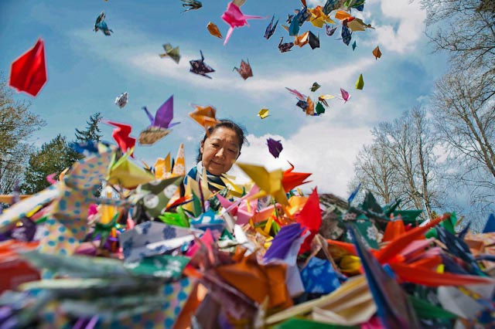
Other Linda Ohama films
Last Harvest, Watari Dori, Neighbours, Wild Horses & Cowboys, The Travelling Reverend, A Sense of Onomichi,

Slide 12
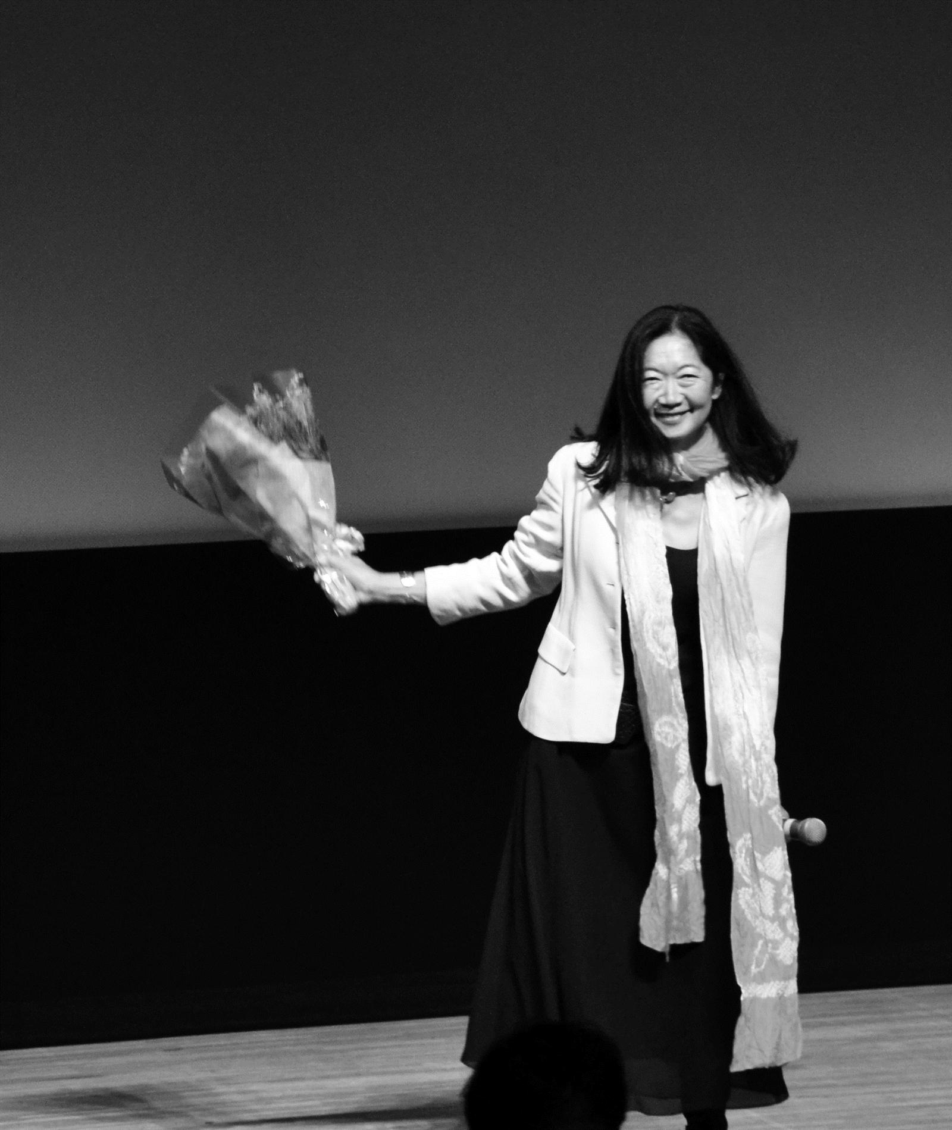
Sakura Sakura, and her current film,Tohoku no Shingetsu, stories from Iwate, Miyagi and Fukushima

Slide 13
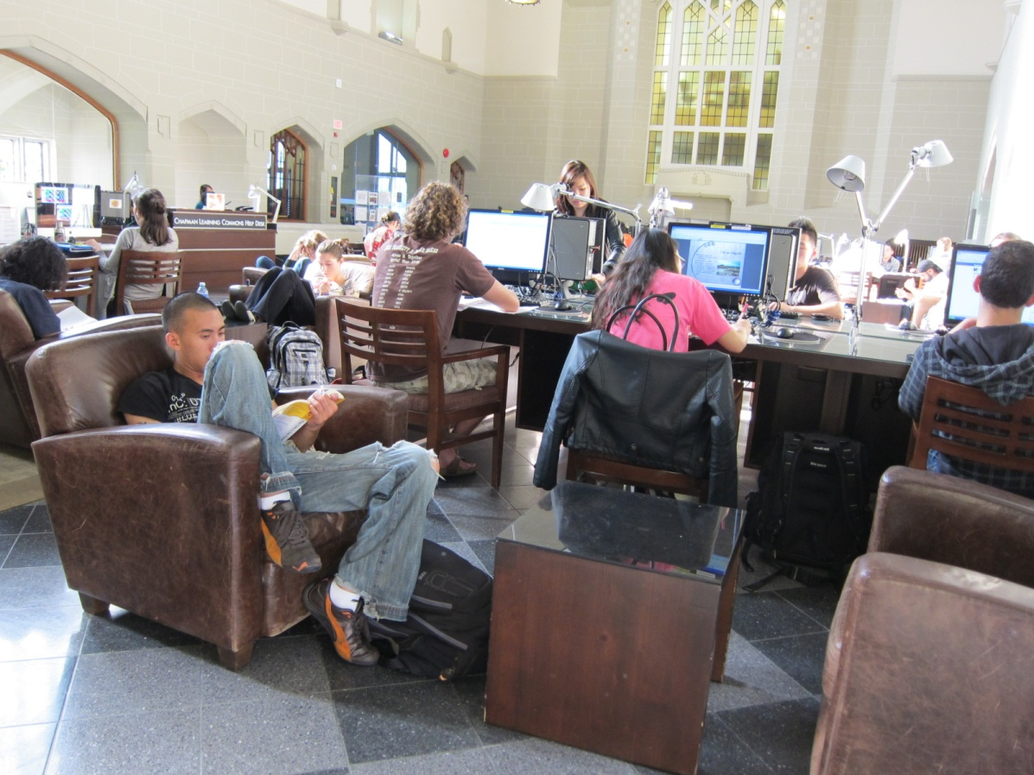
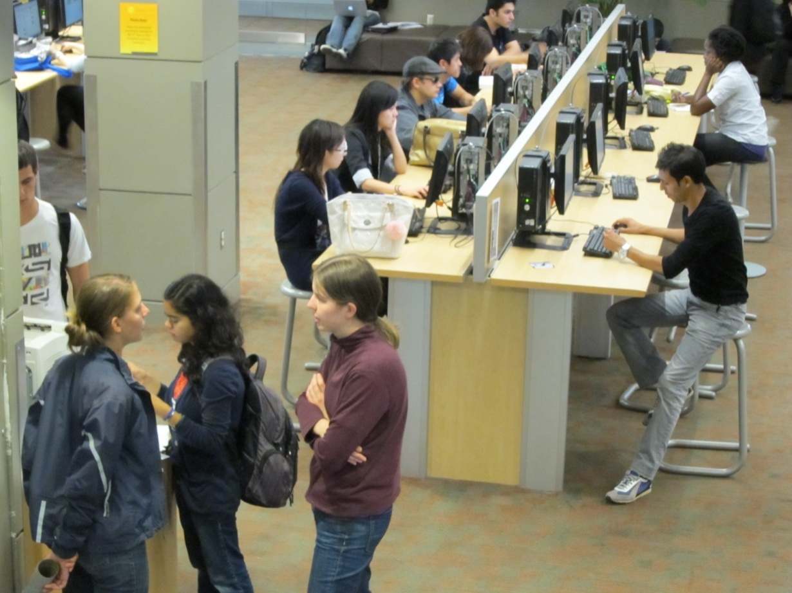
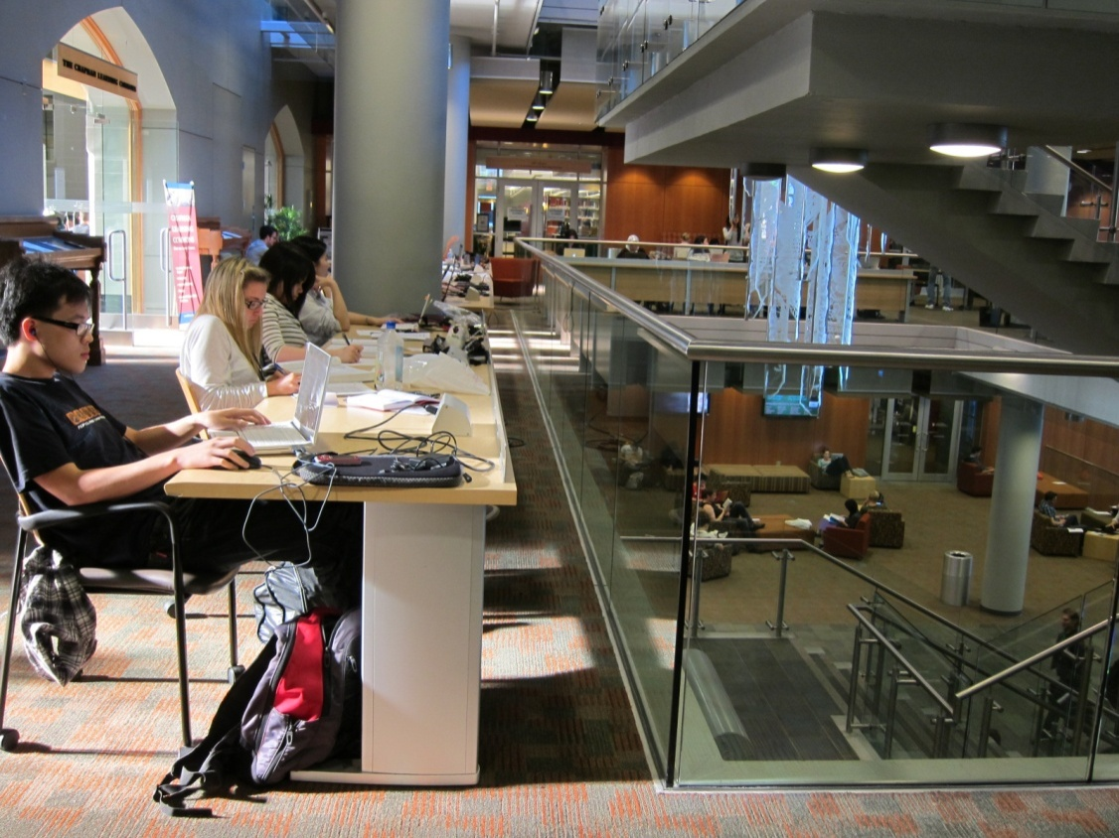
University of British Columbia,
Vancouver

Slide 14
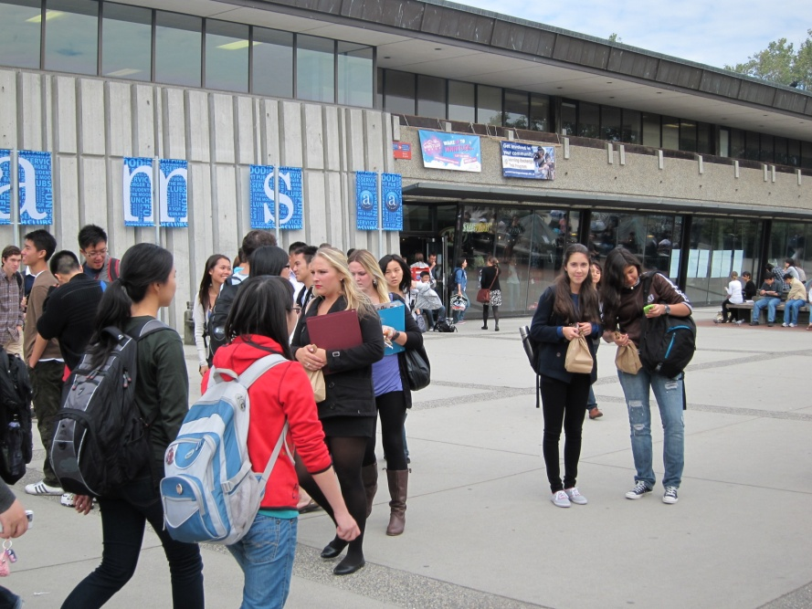
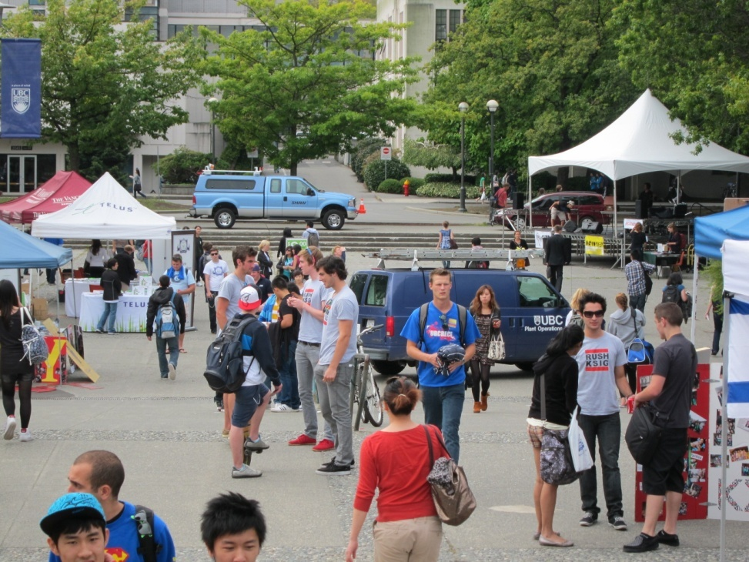
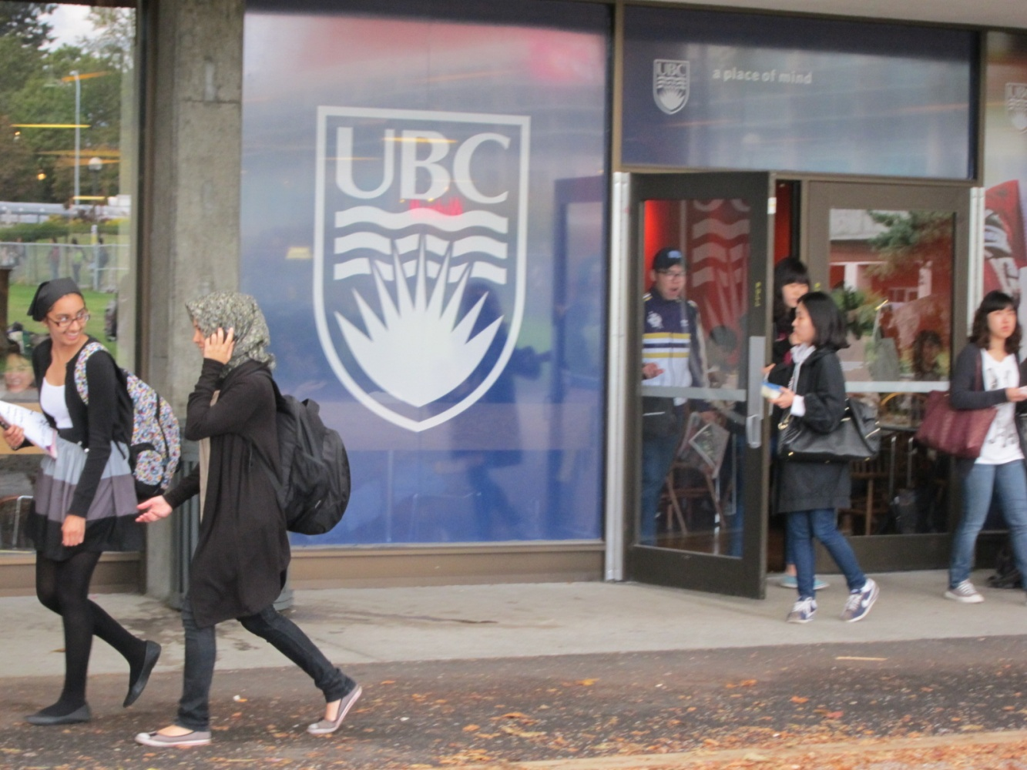
First week of
classes: University
of British Columbia,
Vancouver

Slide 15
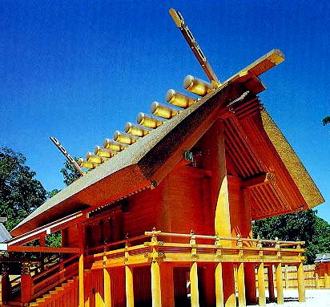
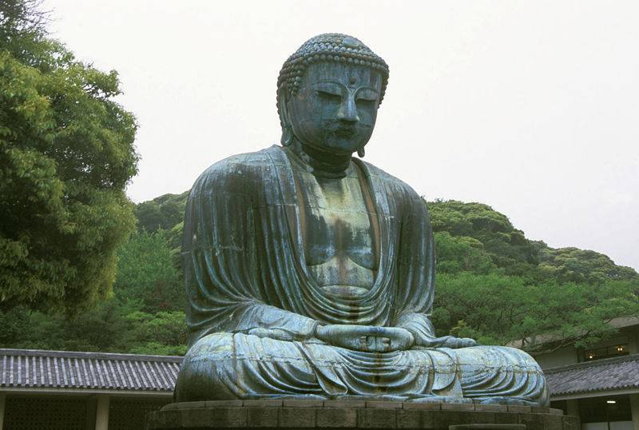
Religion in Japan

Slide 16
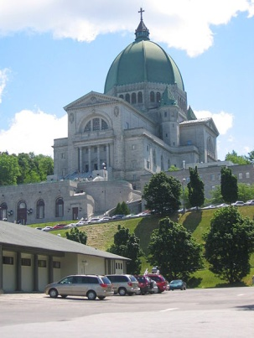
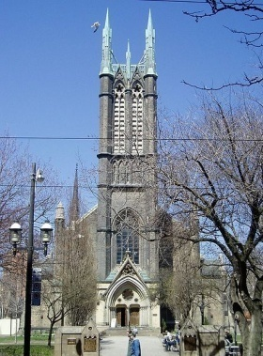
Religion in Canada

Slide 17
Citizenship in Japan
Japan: Race, eligible by descent: issei, nisei, sansei, yonsei, etc.
Notes:
1608- founding of 1st permanent settlement in Canada/U.S., Quebec City
Aboriginal peoples came from a land bridge from Asia, perhaps

Slide 18
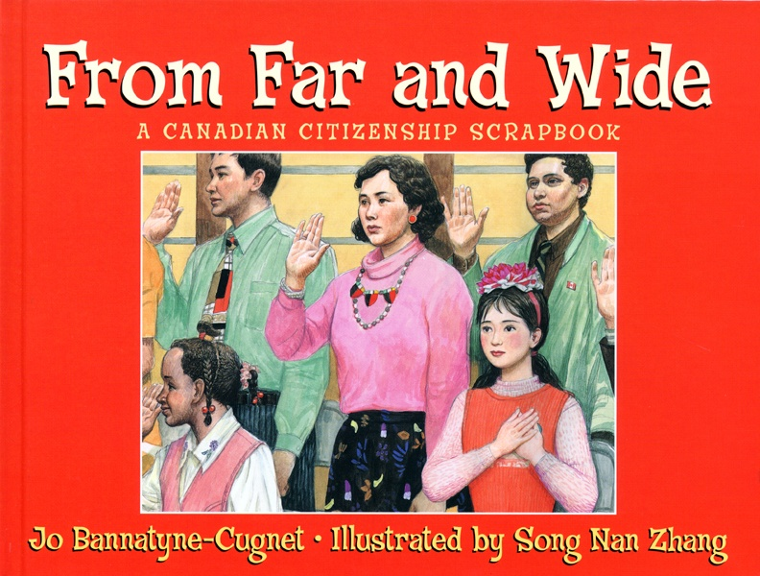
Canada: La Terre, birth in Canada or landed immigrant status
Citizenship in Canada
Notes:
1608- founding of 1st permanent settlement in Canada/U.S., Quebec City
Aboriginal peoples came from a land bridge from Asia, perhaps

Slide 19
Landed Immigrant Status: (2008) immigrating to Canada: 247,202
Immigrating to Canada is based on a point system :
• 6 Classes of immigrants
• Language proficiency in
English or French
• education level
• age (under 40)
Notes:
1608- founding of 1st permanent settlement in Canada/U.S., Quebec City
Aboriginal peoples came from a land bridge from Asia, perhaps

Slide 20
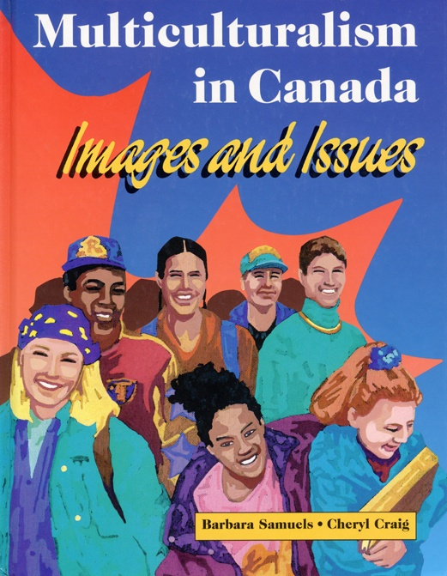
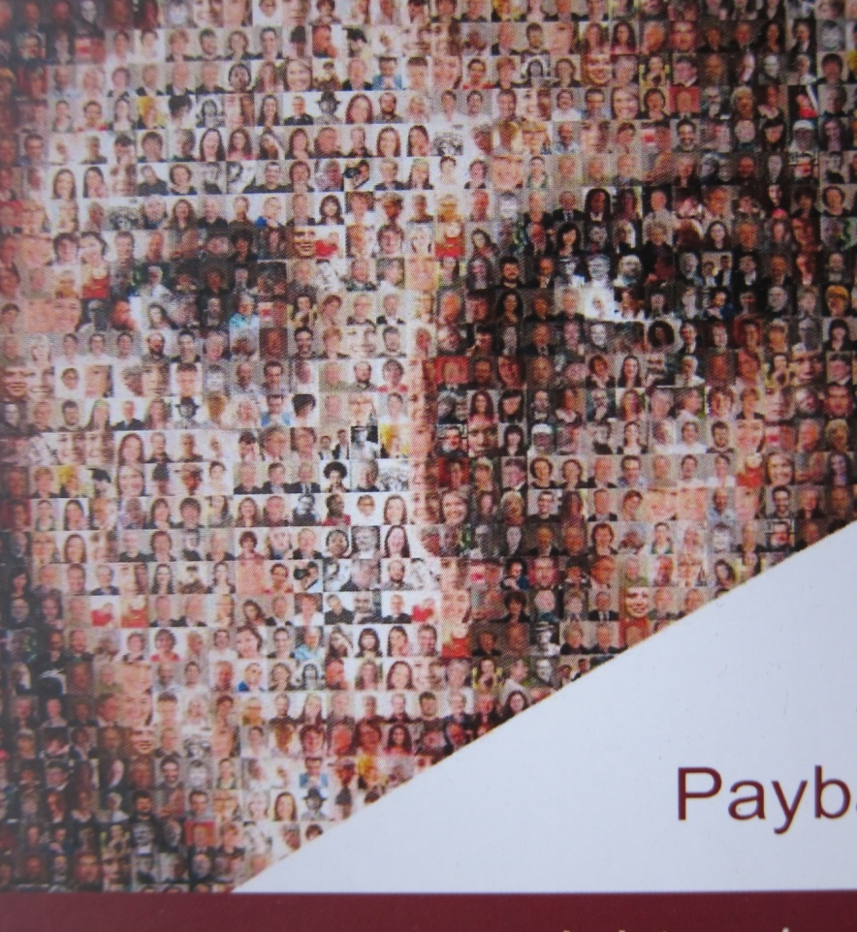
Immigrants can take a written test to become a Canadian citizen after 3 years.
What is a Canadian?
Who makes the rules?
2. What are the rules?
Notes:
1608- founding of 1st permanent settlement in Canada/U.S., Quebec City
Aboriginal peoples came from a land bridge from Asia, perhaps

